Slide 1
EuroGeoSurveys
XXIII ASGMI General Meeting
Cuba, Noviembre 2017
Geological Cooperation between Latin America and Europe:
Geoheritage

Slide 2
Index
Introduction and updates
Since the ASGMI-EGS MoU signature…
EGS activities on Geoheritage

Slide 3
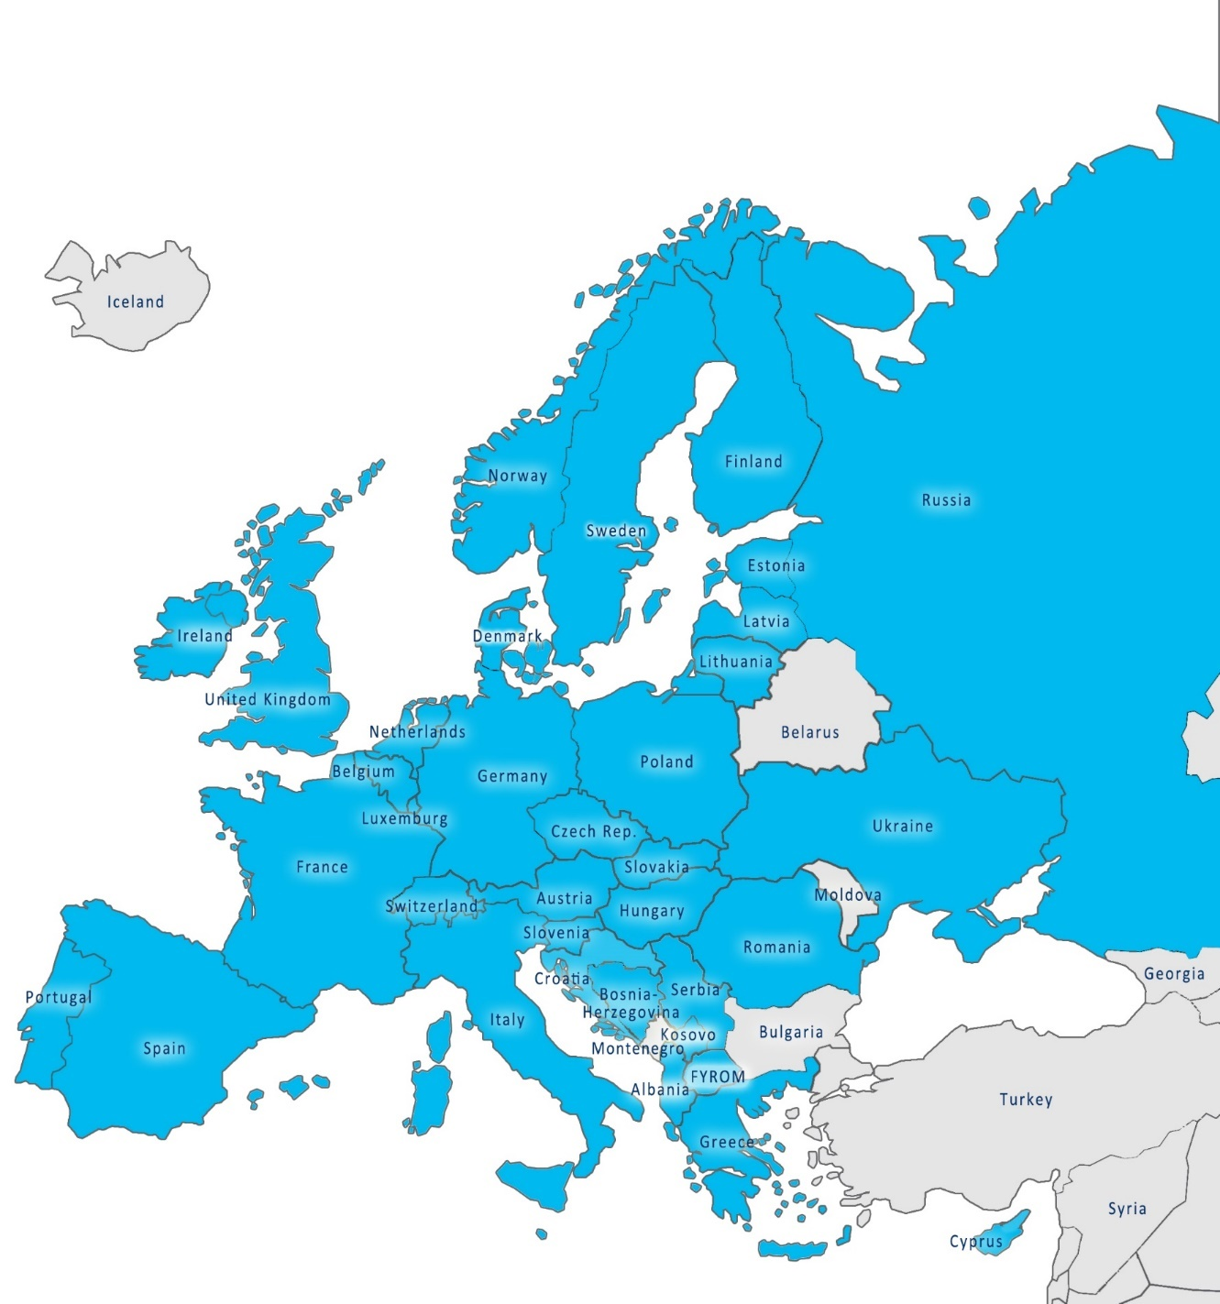
EuroGeoSurveys
Albania
Austria
Belgium
Bosnia & Herzegovina
Croatia
Cyprus
Czech Republic
Denmark
Estonia
Finland
France
FYROM
Germany
Greece
Hungary
Ireland
Italy
Kosovo
Latvia
Lithuania
Luxembourg
The Netherlands
Malta
Norway
Poland
Portugal
Romania
Russian Federation
Serbia
Slovakia
Slovenia
Spain
Sweden
Switzerland
Ukraine
United Kingdom
37 Geological Surveys

Slide 4
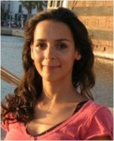
EGS Organisation
BOARD OF DIRECTORS
EXECUTIVE COMMITTEE
SECRETARY GENERAL
New SG:
Mr. Slavko Solar
SECRETARIAT
NATIONAL DELEGATES
EXPERT GROUPS

Slide 5
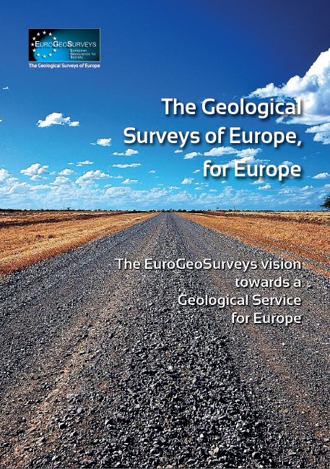
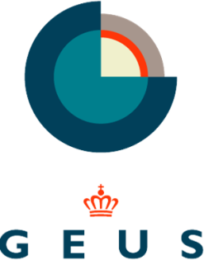
SPATIAL INFORMATION (INSPIRE)
GEOCHEMISTRY
MINERAL RESOURCES
INTERNATIONAL COOPERATION AND DEVELOPMENT
EARTH OBSERVATION
AND GEOHAZARDS
MARINE GEOLOGY
GEOENERGY
WATER RESOURCES

Slide 6
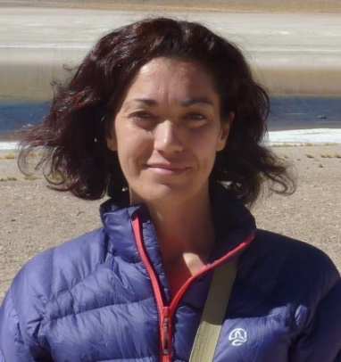
International Cooperation & Development
Chair vacancy
Diana Ponce de Leon
Diana Ponce de Leon (IGME Spain) Deputy Chair in charge of the Latin America affairs
23 Geological Experts and 59 experts

Slide 7
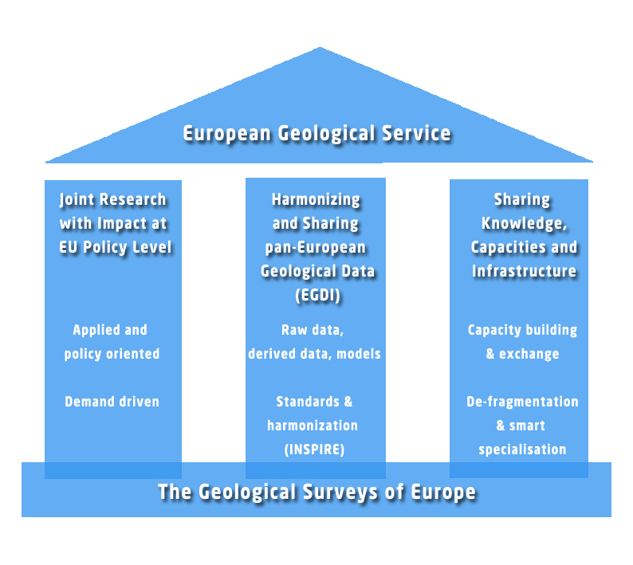
EGS Strategic Vision: towards a European Geological Service
RESEARCH
EXCHANGE
INFRASTRUCTURE

Slide 8
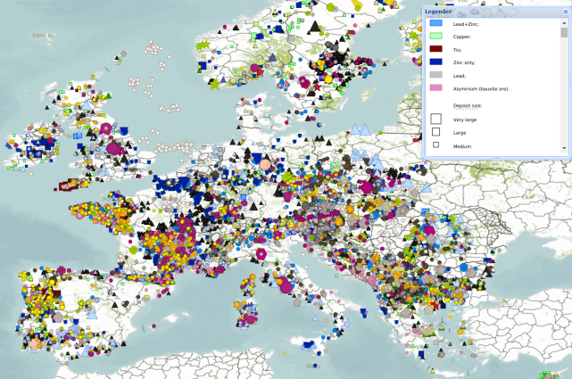
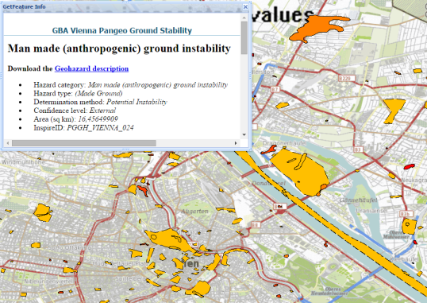
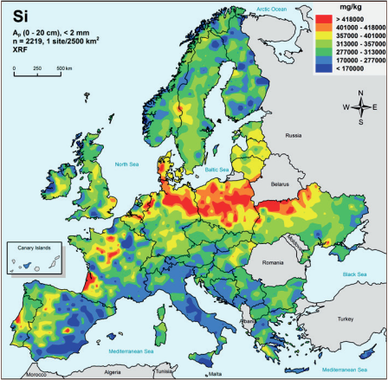
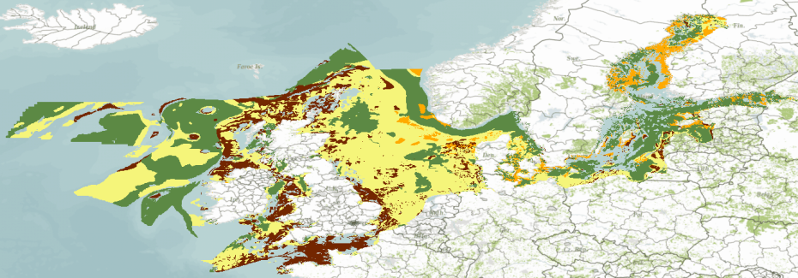
Examples
Mineral deposits; Compiled and harmonised through a number of projects (ProMine, EuroGeoSources, Minerals4EU) using distributed architectures, ISO, OGC and CGI standards
PanGeo; Ground instability assessment of major European cities using PSI data from satellite in combination with in situ data
OneGeologyEurope; Surface geology of Europe in 1:1 mil. Using distributed architecture, including ISO19115 metadata and WMS/ WFS (GeoSciML) services
EMODnet-geology; Marine substrate map. Currently in 1: 1 million, but aiming for 1: 250 000 covering all European waters
GEMAS; geochemical mapping of agricultural and grazing land soils of Europe

Slide 9
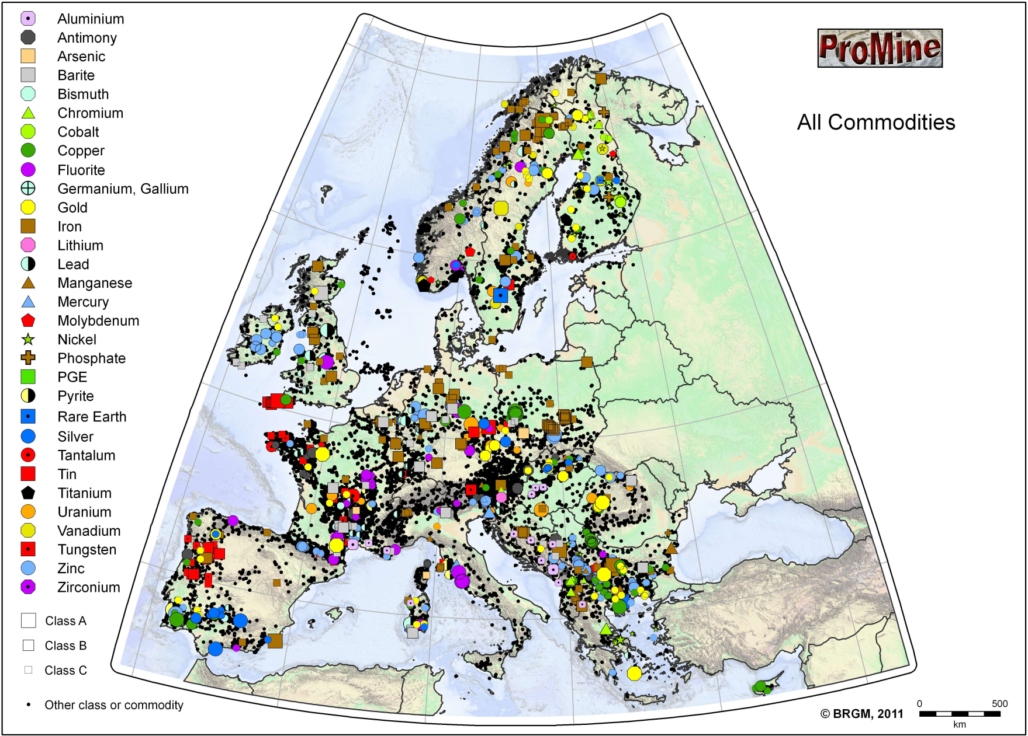
Unique pan-European datasets (mineral deposits)
ProMine mineral deposits database
12,979 records

Slide 10
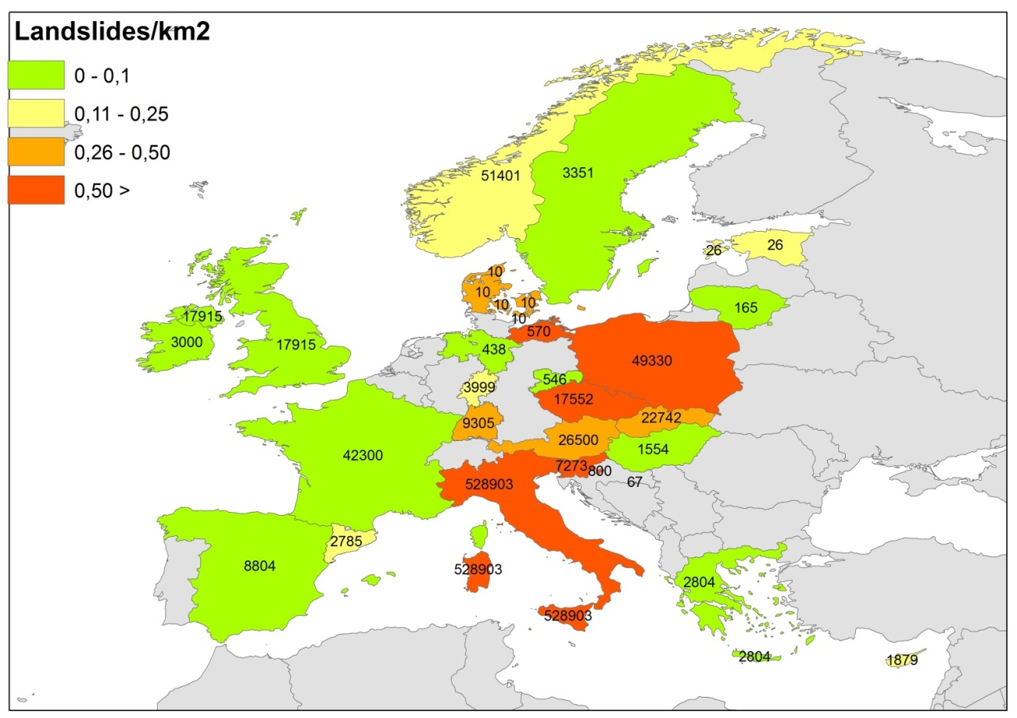
2. EO Geohazards: Geohazard inventories
EGS Landslide & subsidence databases: 801,234 records
Notes:
Otro ejemplo de ello son los inventarios nacionales de movimientos del terreno (movimientos de ladera y subsidencia) realizados y actualizados por los Servicios Geológicos. Dentro del grupo de expertos hemos creado este año un grupo de trabajo en movimientos del terreno con el objetivo de: 1) proporcionar mapas pan-europeos armonizados sobre el estado de los movimientos del terreno;

Slide 11
http://www.europe-geology.eu
V 1.0 is here!

Slide 12
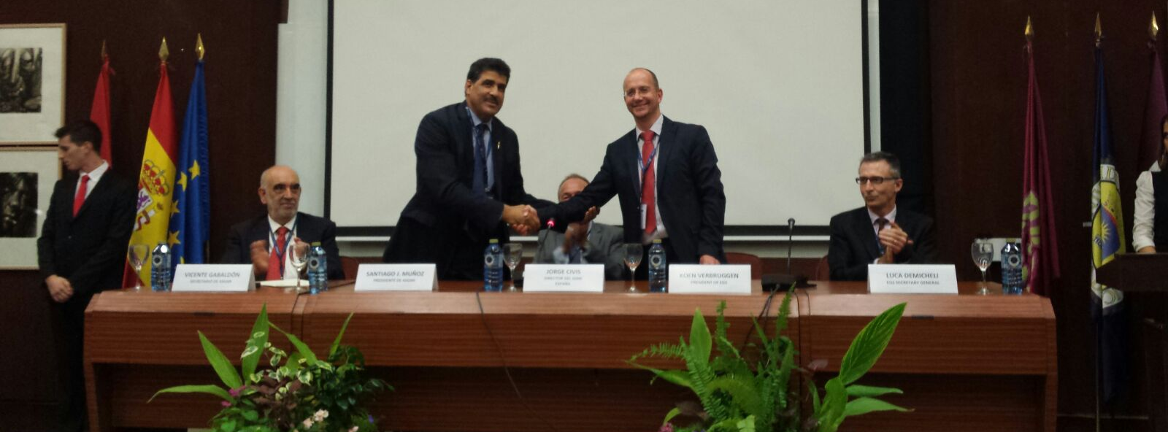
Octube 2015

Slide 13
Since the MoU signature…
Participation in meetings & workshops:
ASGMI EGS joint Directors’ workshop, Madrid 2015
100th Anniversary Geological Survey of Colombia, Bogota, June 2016
ASGMI-EGS workshop Bogota, June 2016
ASM workshop, Quito Ecuador, April 2017
ASGMI General Assembly, La Havana, September 2017
European Innovation Partnership on Raw Materials:
Advancing the idea of a World Forum on Raw Materials FORAM
International Network of Raw Materials Training Centres INTERMIN
Development and Cooperation:
PanLatGeo (together with UNESCO, UNEP, UNDP)
Notes:
Revision of the activieis done since the Mou was signed in october 2015. with the next slide you start to intruduce the topic of the meeting, you could mention the current activities at european level and metion that so far we are not doing anyhting at European level but it is an intersting topic to be explored. The acvities on geheritate or geoconservation are being carry out by our members at national level.

Slide 14
Intermin
To create a self-sustainable long-term lasting international network of training centres for professionals.
involve educational and research institutions in the EU and the leading counterparts in third countries,
based on specific country expertise in the primary and secondary raw materials sectors.
map skills and knowledge in the EU and the third countries,
identify key knowledge gaps and emerging needs,
develop roadmap for improving skills and knowledge,
establish common training programmes in the raw materials sectors.
size of proposals: up to EUR 1 million

Slide 15
This project has received funding from the European Union’s Horizon 2020 research and innovation programme under Grant Agreement No 730127
THE LARGEST INTERNATIONAL COLLABORATIVE PLATFORM ON RAW MATERIALS
An EU-based platform of international experts and stakeholders to enhance international cooperation on raw material policies and investments
Consortium and Advisory Board composed of 70 influencers
A

Slide 16
Geoheritage
A Nivel Europeo (EuroGeoSurveys)
A Nivel Nacional ( Geological Surveys)

Slide 17
Geoheritage in EGS
Desafortunadamente muy pocas actividades a nivel Europeo
EGS & ProGEO MoU-firma en 2014
PanAfGeo Proyeto : WP Patrimonio Geologico

Slide 18
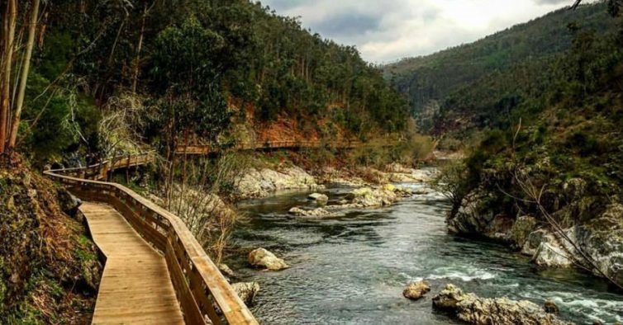
European Association of the Conservation of the Geological Heritage
ProGEO promotes the protection of important geological sites and landscapes, as well as the diverse heritage of geological features with scientific, educational, tourist and cultural relevance.
Geoparque Arouca, Portugal Winner of the geoconservation award 2017, assigned by ProGeo Portuguese Group

Slide 19
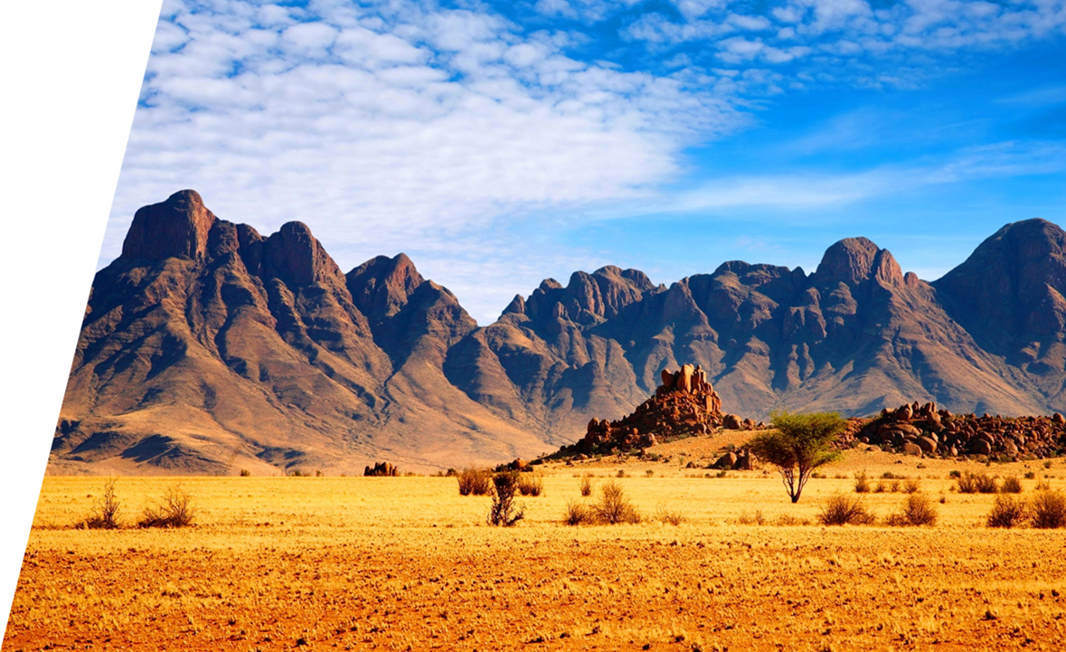
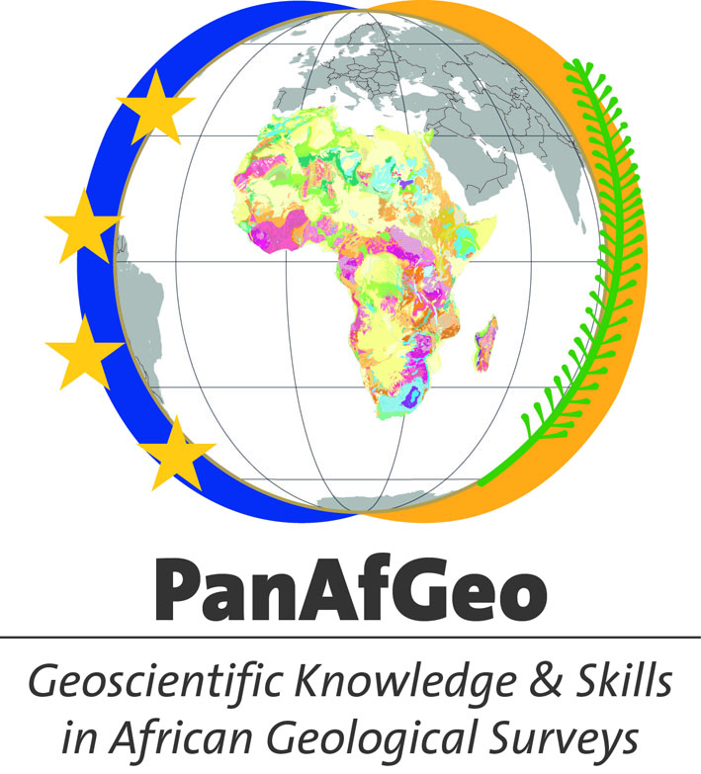
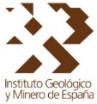
WP06
Geoheritage
Enrique Díaz-Martínez
Geological Survey of Spain
J.M. Djimadoum Nambatingar
Geological Survey of Chad
Co-funded by the
European Union

Slide 20
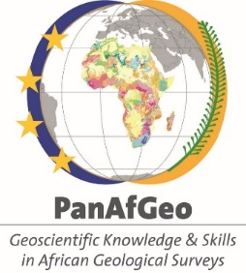
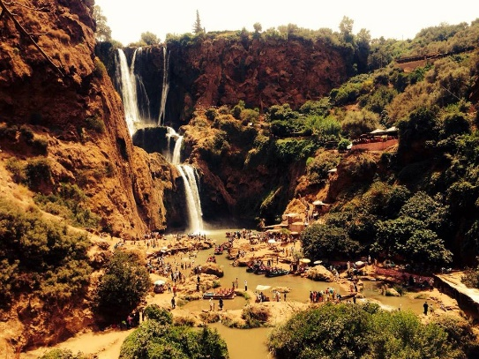
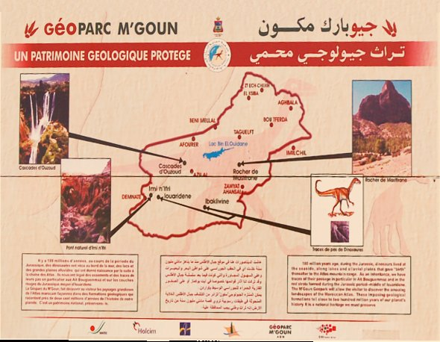
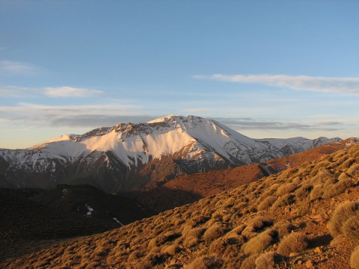
Figures of the work-package
Number of training sessions: 5
Number of days per session: 6 (3 in-room, 3 onsite)
Number of participants per session: 30
Number of trainers per session: 4 (2 EGS, 2 African)
Co-funded by the
European Union

Slide 21
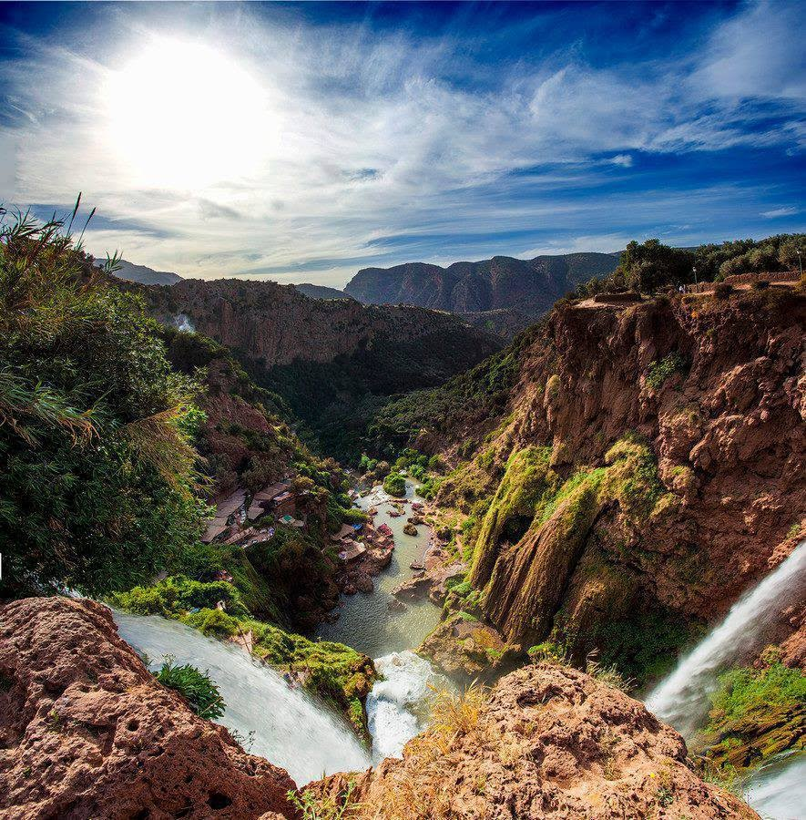
Methodology of the trainings
M’Goun geopark
(Morocco)
- 3 days of lectures and practical training organized at an African GS partner center or education center (e.g., AMGC in Tanzania)
- 3 days of field training in selected geoheritage areas, with proposal of individual and team field projects
The course material will be supplied as electronic files in a pen drive, including published textbooks.
Co-funded by the
European Union

Slide 22
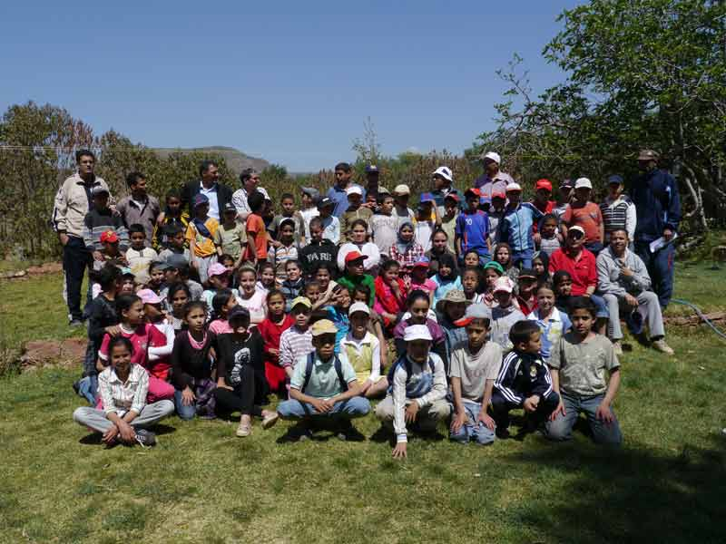
Content of the courses
Training in geoheritage is planned to be organized in logical steps to get knowledge on:
• Inventories: geoheritage identification and assessment
• Legislation (international, national, local)
• Geoconservation: management plans, restoration
• Public outreach, geotourism & geoparks
Includes the specific application to mining heritage and mineral heritage of the concepts, methodology and case studies.
M’Goun geopark (Morocco)
Co-funded by the
European Union

Slide 23
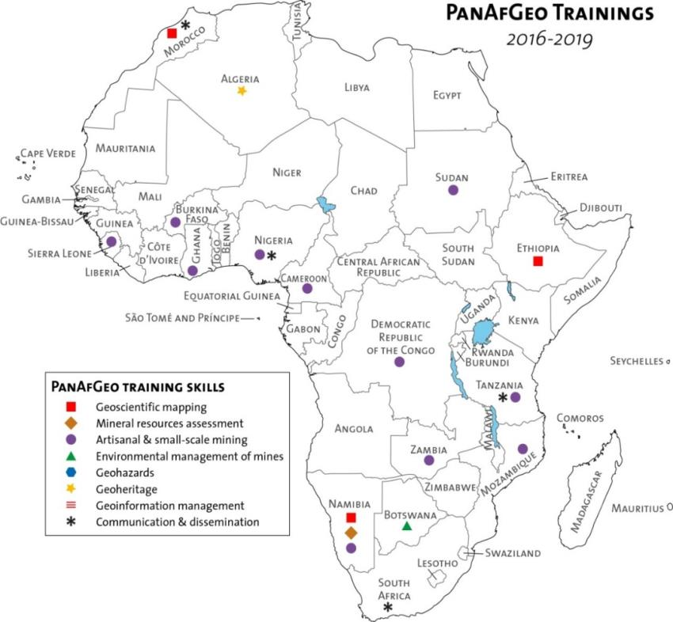
Location of training sessions
Ideal countries with best-practice examples :
Marrakech & M’Goun Geopark (Morocco)
(first Arab and African country in the Global Geoparks Network)
AMGC & Ngorongoro geopark project (Tanzania)
Other countries to be confirmed (please, be proactive!):
Algeria
Namibia
South Africa
Mozambique
Co-funded by the
European Union

Slide 24
Activities in the GSs

Slide 25
National Level
16 GSs in EGS present activities on Geoheritage but very heterogeneuos situation:
Some GSs play a important role in the activities relate to Geoheritage (e.g: Spain, Sweden, Portugal): Legislation, inventories, data providers, ect
Some minor activities
Some Surveys do not present any activitiy at all.

Slide 26
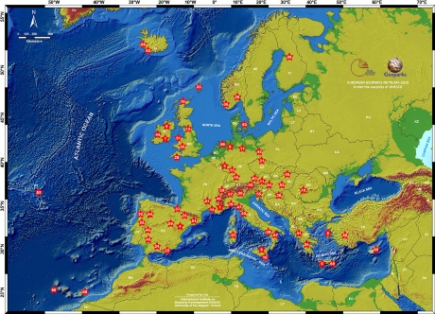
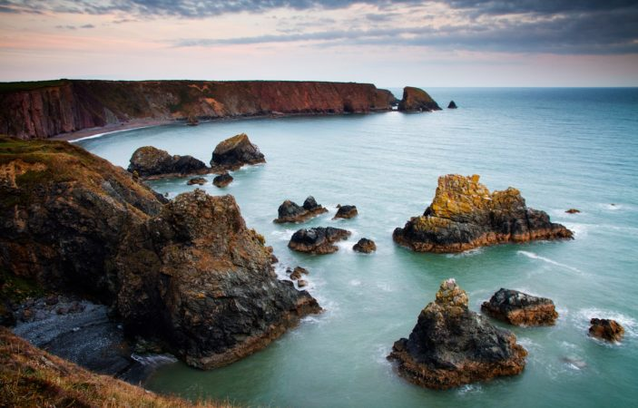
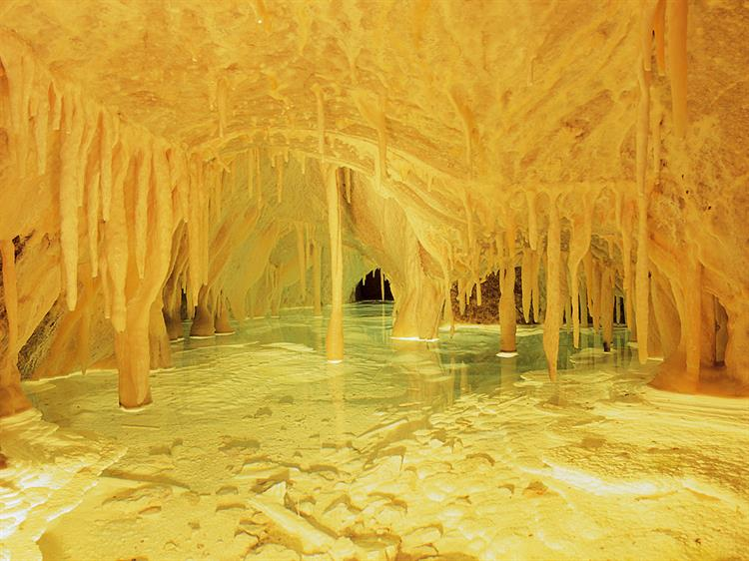
European Geoparks
Ballydowane Bay, Copper Coast Geopark (Ireland)
EUROPEAN GEOPARKS NETWORK (69 Geoparks; 23 European countries;)
Obir Dripstone Caves, Karavanke Geopark (Aústria)
The aim of the network is to support its members to bring sustainable territorial development to the geopark by using that territory’s geological heritage, primarily through the development of geotourism.

Slide 27
For your Information…
Paper presented at the IGC 2016, Cape Town, SA :
“The potential of Geological Surveys in geoconservation”
(Lundqvist,S.1,Ransed,G.1,Hedenström, A.1andDíaz-Martínez,E. 1 Geological Survey of Sweden (SGU) and 2 Geological Survey of Spain (IGME)

Slide 28
Muchas gracias

